Slide 1
Java RMI
(Remote Method Invocation)

Slide 2
Distributed system, distributed computing
Early computing was performed on a single processor. Uni-processor computing can be called centralized computing.
A distributed system is a collection of independent computers, interconnected via a network, capable of collaborating on a task.
Distributed computing is computing performed in a distributed system.

Slide 3
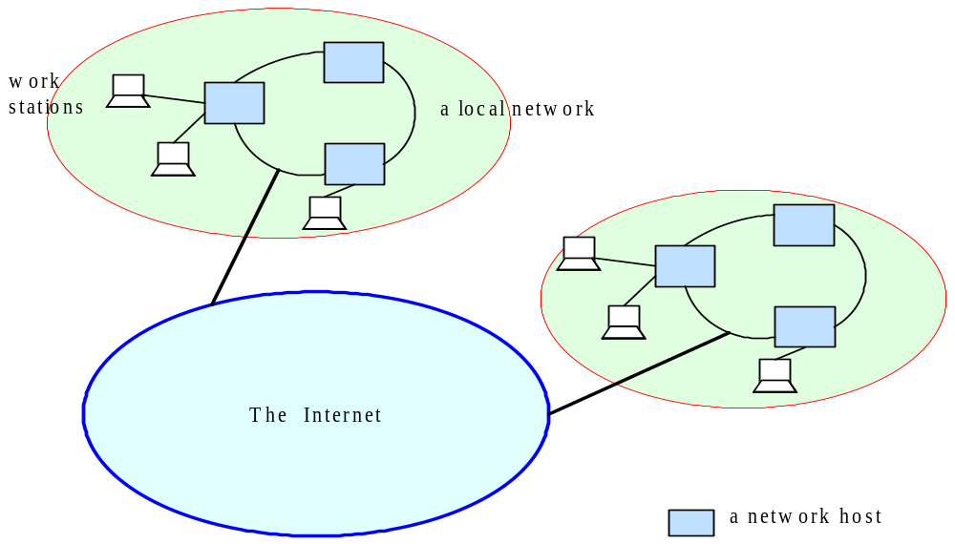
Distributed Systems

Slide 4
Examples of Distributed systems
Network of workstations (NOW): a group of networked personal workstations connected to one or more server machines.
The Internet
An intranet: a network of computers and workstations within an organization, segregated from the Internet via a protective device (a firewall).

Slide 5
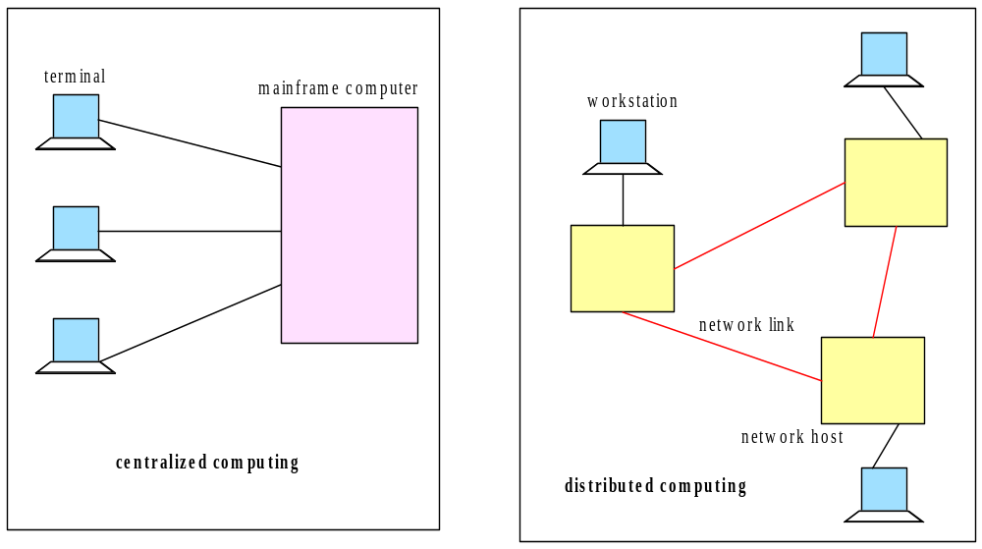
Centralized vs. Distributed Computing

Slide 6
Why distributed computing?
Economics: distributed systems allow the pooling of resources, including CPU cycles, data storage, input/output devices, and services.
Reliability: a distributed system allow replication of resources and/or services, thus reducing service outage due to failures.
The Internet has become a universal platform for distributed computing.

Slide 7
Dist. Computing: Weaknesses and Strengths
In any form of computing, there is always a tradeoff in advantages and disadvantages
Some of the reasons for the popularity of distributed computing :
  The affordability of computers and availability of network access
  Resource sharing
  Scalability
  Fault Tolerance

Slide 8
Dist. Computing: Weaknesses and Strengths
The disadvantages of distributed computing:
Multiple Points of Failures: the failure of one or more participating computers, or one or more network links, can spell trouble.
Security Concerns: In a distributed system, there are more opportunities for unauthorized attack.

Slide 9
Related Technologies
RPC (“Remote Procedure Calls”)
  Developed by Sun
  Platform-specific
CORBA (“Common Object Request Broker Architecture”)
  Developed by OMG
  Access to non-Java objects (as well as Java)
DCOM (“Distributed Component Object Model”)
  Developed by Microsoft
  Access to Win32 objects
LDAP (“Lightweight Directory Access Protocol”)
  Finding resources on a network

Slide 10
RMI Overview
Remote Method Invocation (RMI) is a distributed systems technology that allows one Java Virtual Machine (JVM) to invoke object methods that will be run on another JVM located elsewhere on a network.
RMI is a Java technology that allows one JVM to communicate with another JVM and have it execute an object method. Objects can invoke methods on other objects located remotely as easily as if they were on the local host machine
Each RMI service is defined by an interface, which describes object methods that can be executed remotely. This interface must be shared by all developers who will write software for that service—it acts as a blueprint for applications that will use and provide implementations of the service.

Slide 11
What Is RMI?
Access to Remote Objects
Java-to-Java only
Client-Server Protocol
High-level API
Transparent
Lightweight

Slide 12
Remote Objects (Diagram)
Java Virtual Machine
Java Virtual Machine
TCP
Client Object
Remote Object

Slide 13
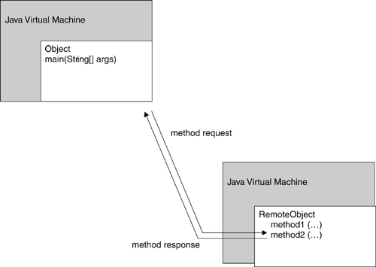
Remote method invocation
Invocation of a method on a remote object, executing on a remote machine

Slide 14
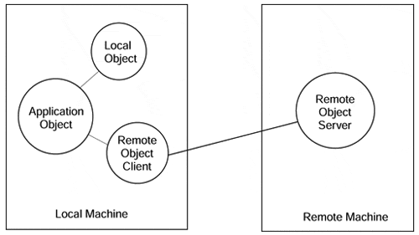
Local object – Remote object
Invocations on remote objects appear the same as invocations on local objects.

Slide 15
RMI Layers
Java Virtual Machine
Java Virtual Machine
Client Object
Remote Object
Stub
Skeleton
TCP
Remote Reference Layer
Remote Reference Layer
Transport Layer
Transport Layer

Slide 16
Registries
Name and look up remote objects
Servers can register their objects
Clients can find server objects and obtain a remote reference
A registry is a running process on a host machine

Slide 17
Remote References and Interfaces
Remote References
  Refer to remote objects
  Invoked on client exactly like local object references
Remote Interfaces
  Declare exposed methods
  Implemented on client
  Like a proxy for the remote object

Slide 18
Stubs and Skeletons
Stub
  lives on client
  pretends to be remote object
Skeleton
  lives on server
  receives requests from stub
  talks to true remote object
  delivers response to stub

Slide 19
Remote Interfaces and Stubs
Remote Interface
implements
implements
Client
Stub
Skeleton
Remote Object
(Server)

Slide 20
RMI System Architecture
Client Virtual Machine
Server Virtual Machine
Client
Remote Object
Skeleton
Stub
Server
“Fred”
Registry Virtual Machine

Slide 21
RMI Flow
1. Server Creates Remote Object
2. Server Registers Remote Object
Client Virtual Machine
Server Virtual Machine
Client
Remote Object
1
Skeleton
Stub
Server
2
“Fred”
Registry Virtual Machine

Slide 22
RMI Flow
3. Client requests object from Registry
4. Registry returns remote reference
(and stub gets created)
Client Virtual Machine
Server Virtual Machine
Client
Remote Object
Skeleton
Stub
Server
3
4
“Fred”
Registry Virtual Machine

Slide 23
RMI Flow
5. Client invokes stub method
6. Stub talks to skeleton
7. Skeleton invokes remote object
method
Client Virtual Machine
Server Virtual Machine
Client
Remote Object
5
7
6
Skeleton
Stub
Server
“Fred”
Registry Virtual Machine

Slide 24
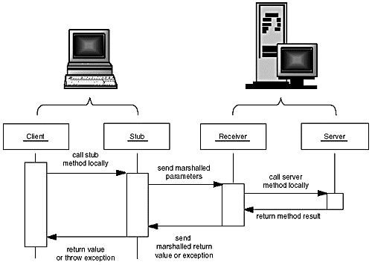
Parameter marshalling

Slide 25
RMI Applications
RMI applications are often comprised of two separate programs: a server and a client.
A typical server application creates some remote objects, makes references to them accessible, and waits for clients to invoke methods on these remote objects.
A typical client application gets a remote reference to one or more remote objects in the server and then invokes methods on them. RMI provides the mechanism by which the server and the client communicate and pass information back and forth.
Such an application is sometimes referred to as a distributed object application.

Slide 26
Creating Distributed Applications Using RMI
Design and implement the components of your distributed application.
Compile sources and generate stubs.
Make classes network accessible.
Start the application.
Design and Implement the Application Components
Defining the remote interfaces: A remote interface specifies the methods that can be invoked remotely by a client.
Implementing the remote objects: Remote objects must implement one or more remote interfaces. The remote object class may include implementations of other interfaces (either local or remote) and other methods (which are available only locally).
Implementing the clients: Clients that use remote objects can be implemented at any time after the remote interfaces are defined, including after the remote objects have been deployed.

Slide 27
Designing a Remote Interface
Your client program needs to manipulate server objects, but it doesn't actually have copies of them. The objects themselves reside on the server. The client code must still know what it can do with those objects.
Any system that uses RMI will use a service interface. The service interface defines the object methods that can be invoked remotely, and specifies parameters, return types, and exceptions that may be thrown.
All RMI service interfaces extend the java.rmi.Remote interface, which assists in identifying methods that may be executed remotely. To define a new interface for an RMI system, you mustdeclare a new interface extending the Remote interface and All the methods in those interfaces must also declare that they will throw a RemoteException.

Slide 28
Designing a Remote Interface
Define a Remote Interface
  extends java.rmi.Remote
Define a class that implements the Remote Interface
  extends java.rmi.RemoteObject
  or java.rmi.UnicastRemoteObject

Slide 29
Designing a Remote Interface
package rmidemo;
import java.rmi.*;
public interface Product extends Remote{
String getDescription() throws RemoteException;
}

Slide 30
Implementing a Remote Interface
In general the implementation class of a remote interface should at least
  Declare the remote interfaces being implemented
  Define the constructor for the remote object
  Provide an implementation for each remote method in the remote interfaces
The server needs to create and to install the remote objects. This setup procedure can be encapsulated in a main method in the remote object implementation class itself, or it can be included in another class entirely. The setup procedure should
  Create and install a security manager
  Create one or more instances of a remote object
  Register at least one of the remote objects with the RMI remote object registry (or another naming service such as one that uses JNDI), for bootstrapping purposes

Slide 31
Implementing a Remote Interface
import java.rmi.*;
import java.rmi.server.*;
public class ProductImpl extends UnicastRemoteObject implements Product {
private String name;
public ProductImpl(String n) throws RemoteException {
super();
name = n;
}
public String getDescription() throws RemoteException {
return "I am a " + name + ". Buy me!";
}
}

Slide 32
Compiling Remote Classes
Compile the Java class
  javac
    reads .java file
    produces .class file
Compile the Stub and Skeleton
  rmic
    reads .class file
    produces _Skel.class and _Stub.class

Slide 33
Naming conventions for RMI classes
Product A remote interface
ProductImpl A server class implementing that interface
ProductImpl_Stub A stub class that is automatically generated by the rmic program
ProductImpl_Skel A skeleton class that is automatically generated by the rmic program needed for SDK 1.1
ProductServer A server program that creates server objects
ProductClient A client program that calls remote methods

Slide 34
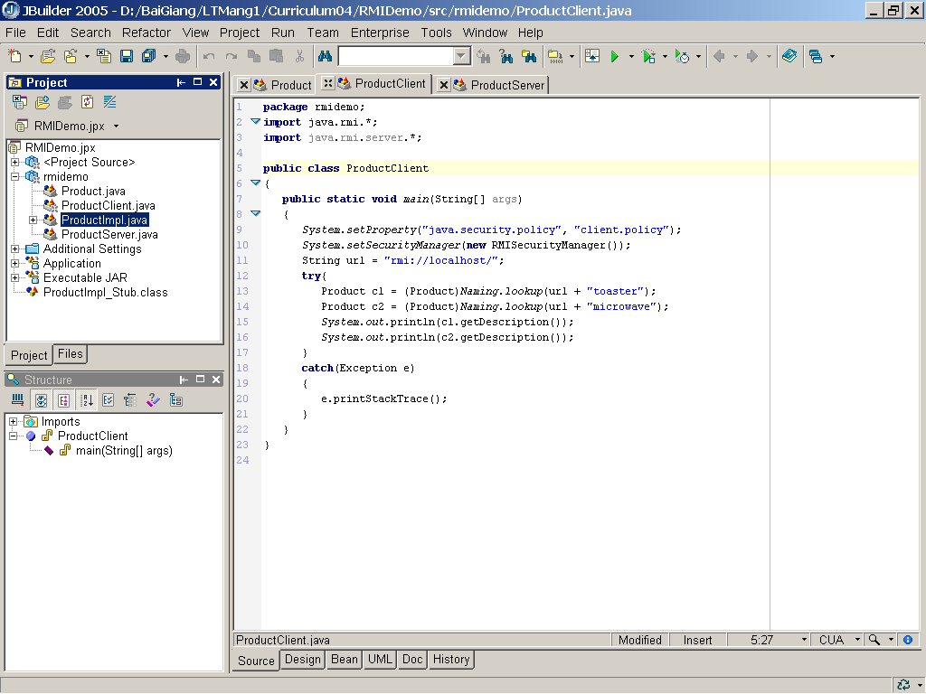
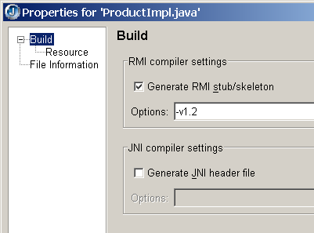
Creating Stub and Skeleton Classes

Slide 35
Creating an RMI Server
import java.rmi.*;
import java.rmi.server.*;
public class ProductServer {
public static void main(String args[]) {
try {
System.out.println("Constructing server implementations...");
// Load the service
ProductImpl EOS350D = new ProductImpl("Canon EOS 350D");
// Load another service
ProductImpl nikon70D = new ProductImpl("Nikon 70D");
System.out.println ("Binding server implementations to registry...");

Slide 36
Creating an RMI Server
// Registration format: rmi://registry_hostname :port /service
Naming.rebind("rmi://localhost/EOS350D", EOS350D);
Naming.rebind("rmi://localhost/nikon70D", nikon70D);
System.out.println ("Waiting for invocations from clients...");
}
catch (RemoteException re) {
System.err.println ("Remote Error - " + re);
}
catch (Exception e) {
System.out.println(e.getMessage());
}
}
}

Slide 37
Starting the server
Our server program isn't quite ready to run, yet. Because it uses the bootstrap RMI registry, that service must be available. To start the RMI registry under UNIX, you execute the statement
rmiregistry &
Under Windows, call
start rmiregistry
at a DOS prompt or from the Run dialog box. (The start command is a Windows command that starts a program in a new window.)
Now you are ready to start the server. Under UNIX, use the command:
java ProductServer &
Under Windows, use the command:
start java ProductServer

Slide 38
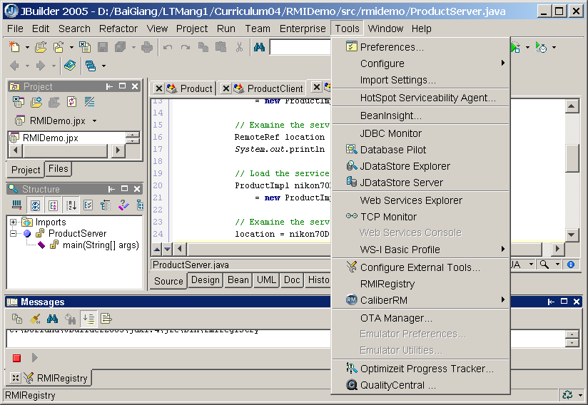
Starting the server in JBuilder

Slide 39
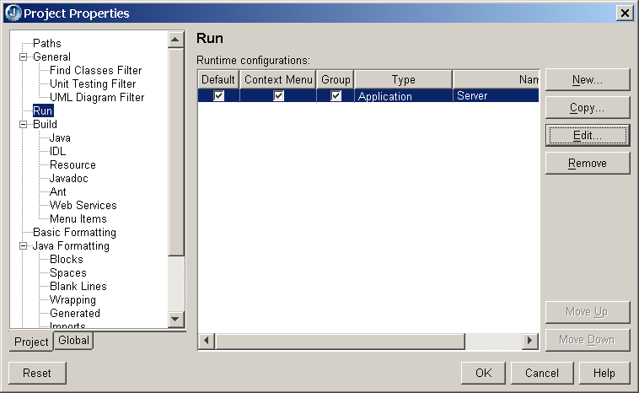
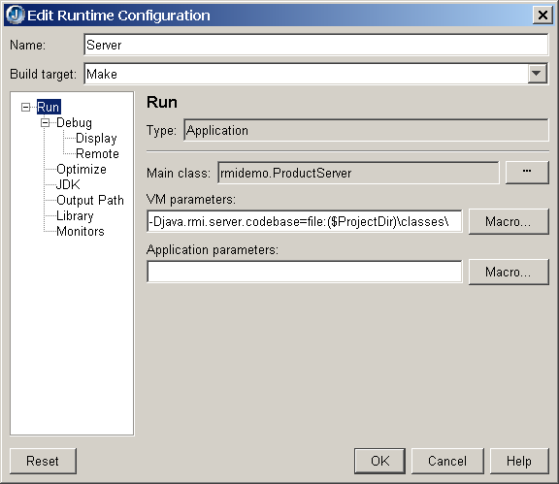
Start the server class

Slide 40
Creating an RMI Client
public class ProductClient {
public static void main(String[] args) {
System.setProperty("java.security.policy", "client.policy");
System.setSecurityManager(new RMISecurityManager());
// Registration format: rmi://registry_hostname :port /service
// Note the :port field is optional
String url = "rmi://localhost/";
try{
// Lookup the service in the registry, and obtain a remote service
Remote remoteService1 = Naming.lookup(url + "EOS350D");
Remote remoteService2 = Naming.lookup(url + "nikon70D");
// Cast to a Product interface
Product c1 = (Product) remoteService1;
Product c2 = (Product) remoteService2;
System.out.println(c1.getDescription());
System.out.println(c2.getDescription());
}
catch(Exception e) {
e.printStackTrace();
} }}

Slide 41
Running the client
By default, the RMISecurityManager restricts all code in the program from establishing network connections. But the program needs to make network connections
  To reach the RMI registry;
  To contact the server objects.
To allow the client to connect to the RMI registry and the server object, you need to supply a policy file.. Here is a policy file that allows an application to make any network connection to a port with port number at least 1024. (The RMI port is 1099 by default, and the server objects also use ports 1024.)
grant {
permission java.net.SocketPermission
"*:1024-65535", "connect";
};
In the client program, we instruct the security manager to read the policy file, by setting the java.security.policy property to the file name.
System.setProperty("java.security.policy", "client.policy")

Slide 42
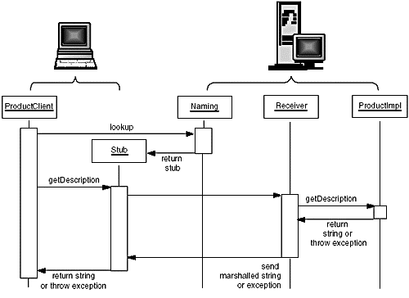
Calling the remote getDescription method

Slide 43
Remote Interfaces vs. Remote Classes
Remember that the reference is to an interface
You must make references, arrays, etc. out of the interface type, not the implementation type
You can’t cast the remote reference to a normal reference
So name your Remote Objects with “Impl” (so you don’t get confused)

Slide 44
Parameter Passing
Primitive types
  passed by value
Remote objects
  passed by reference
Non-remote objects
  passed by value
  uses Java Object Serialization

Slide 45
Java Serialization
Writes object as a sequence of bytes
Writes it to a Stream
Recreates it on the other end
Creates a brand new object with the old data

Slide 46
java.io.Serializable
Objects that implement the java.io.Serializable interface are marked as serializable
Also subclasses
Magically, all non-static and non-transient data members will be serialized
Actually, it’s not magic, it’s Reflection (it’s done with mirrors)
empty interface - just a marker
It’s a promise

Slide 47
Not All Objects Are Serializable
Any object that doesn’t implement Serializable
Any object that would pose a security risk
  e.g. FileInputStream
Any object whose value depends on VM-specific information
  e.g. Thread
Any object that contains a (non-static, non-transient) unserializable object (recursively)

Slide 48
NotSerializableException
thrown if you try to serialize or unserialize an unserializable object
maybe you subclassed a Serializable object and added some unserializable members

Slide 49
Serial Version UID
The serialVersionUID is a universal version identifier for a Serializable class. Deserialization uses this number to ensure that a loaded class corresponds exactly to a serialized object. If no match is found, then an InvalidClassException is thrown
Guidelines for serialVersionUID :
always include it as a field, for example: "private static final long serialVersionUID = 7526472295622776147L; " include this field even in the first version of the class, as a reminder of its importance
do not change the value of this field in future versions, unless you are knowingly making changes to the class which will render it incompatible with old serialized objects
new versions of Serializable classes may or may not be able to read old serialized objects; it depends upon the nature of the change;

Slide 50
Incompatible Changes
Adding or removing members
Changing a nonstatic field to static or a nontransient field to transient
Changing the declared type of a primitive field
. . . . . . . . . .
java.io.InvalidClassException thrown if you try to deserialize an incompatible object stream

Slide 51
Serial Version
If the changes were actually compatible
find out the Serial Version UID of the original class
  use the serialver utility
add a member variable to the changed class
  protected static final long serialVersionUID = -2215190743590612933L;
now it’s marked as compatible with the old class

Slide 52
RMI Applications for JDK 1.5
pregenerating a stub class for a remote object's class is only required if the remote object needs to support pre-5.0 clients. As of the 5.0 release, if a pregenerated stub class for a remote object's class cannot be loaded when the remote object is exported, the remote object's stub class is generated dynamically.
Designing a Remote Interface
Implementing a Remote Interface
Creating a RMI Server
Createing a RMI Client

Slide 53
RMI Applications for JDK 1.5
Creating a RMI Server
Installs a new RMISecurityManager
System.setProperty("java.security.policy", "client.policy"); System.setSecurityManager(new RMISecurityManager());
Both the server and client applications use a security policy file that grants permissions only to files in the local class path (the current directory). The server application needs permission to accept connections, and both the server and client applications need permission to make connections. The permission java.net.SocketPermission is granted to the specified codebase URL, a "file:" URL relative to the current directory. This permission grants the ability to both accept connections from and make connections to any host on unprivileged ports (that is ports >= 1024).
grant codeBase "file:." {
permission java.net.SocketPermission "*:1024-", "connect,accept";
};

Slide 54
RMI Applications for JDK 1.5
Creating a RMI Server
Creates and exports a Registry instance on the local host that accepts requests on the specified port
Registry RMIReg = LocateRegistry.createRegistry(1099);
Creates a remote object
ProductImpl EOS350D = new ProductImpl("Canon EOS 350D");
Binds a remote reference to the specified name in this registry
RMIReg.bind("EOS350D", EOS350D);

Slide 55
RMI Applications for JDK 1.5
Creating a RMI Client
Installs a new RMISecurityManager
System.setProperty("java.security.policy", "client.policy");
System.setSecurityManager(new RMISecurityManager());
Getss a reference to the remote object Registry on the specified host and port. If host is null, the local host is used.
Registry RMIReg = LocateRegistry.getRegistry("localhost",1099);
Lookups the service in the registry, and obtain a remote service
Remote remoteService1 = RMIReg.lookup("EOS350D");
Cast to a Remote (Product) interface
Product c1 = (Product) remoteService1;

